Slide 1
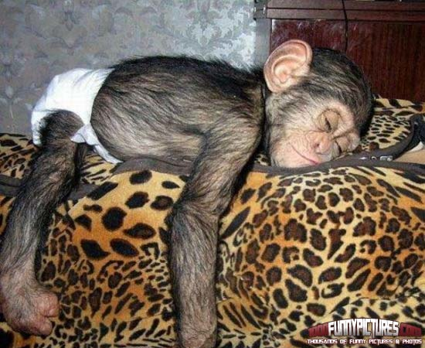
The Importance of Sleep: Sleep-Fit
Santiago Agudelo, Bob Feddell, Charles Florestal,
Ivan Kalytovskyy, & Leslie Yanes

Slide 2
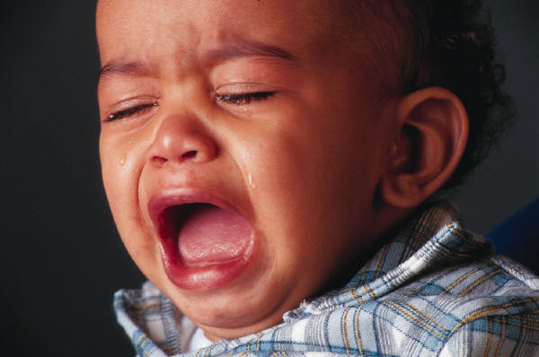
Why is Sleep Important?
helps promote health and recovery.
is a physical need all human beings have.
regarded as precious, because problems
with sleep are often reported and affect an
individual’s over all well-being.
Notes:
(Marino, Yi Li, Rueschman, Winkelman, Ellenbogen, Dulin, Berkman & Buxton, 2013)

Slide 3

Studies Show that Reduced Sleep:
Adds to tiredness, aggression, moodiness & irritability
Decreases pain tolerance
Can increased confused reactions
Weakens immunity defenses
Negatively affects attention span
Notes:
(Marino et al., 2013) With sleepfit you can help eliminate all these negative symptoms.

Slide 4
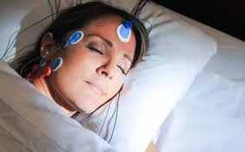
Measuring Sleep:
Overtime objective and subjective data has been collected to measure sleep. However clinicians perception of patients’ sleep and patient’s’ self- reported assessment of sleep, hasn’t precisely added to the same results, indicating that subjective data can only be useful when taking into account patient’s own perception on his or her sleep and used in combination with objective data.
Notes:
(Richarson, Crow, Coghill, & Turnock, 2005) Sleepfit combines both objective and subjective data to give you the best self-monitoring measures of your sleep. The only better way to measure sleep that using sleepfit would be in a sleeping laboratory by professionals, but that would be more expensive and make it harder for you to manage your own progress and seek immediate improvements.

Slide 5
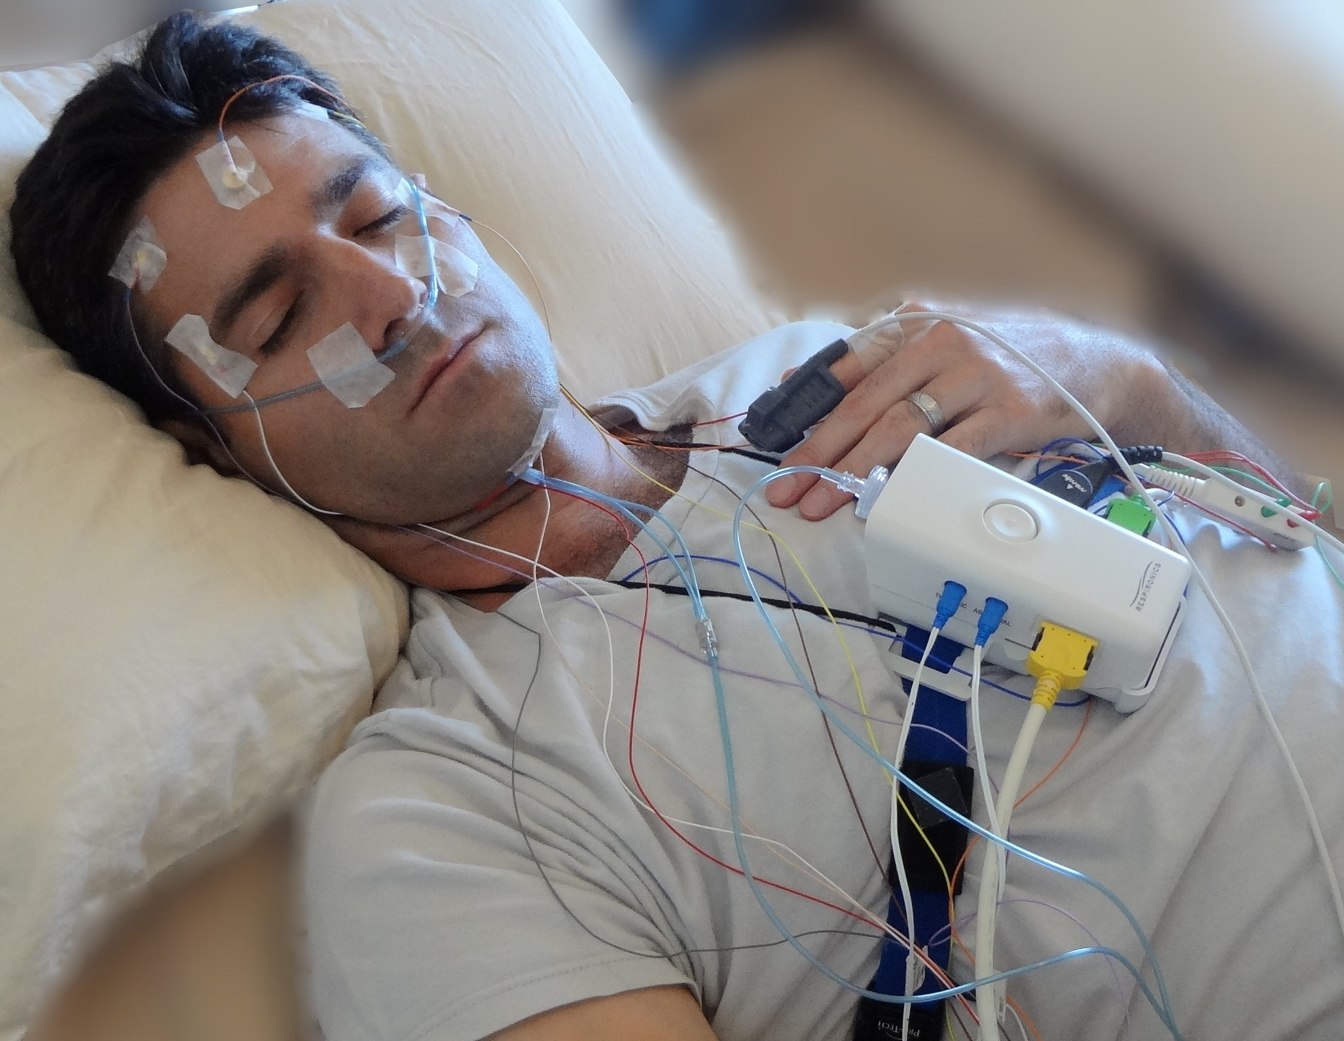
Objective:Polysomnograph Sleep Measurements
Electroencephalogram (EEG) electrical brain activity
Electromyogram (EMG) recording of muscle activity during sleep
Electroculogram (EOG) recording of eye movement
Notes:
OBJECTIVE MEASURING TOOL: Most effective and accurate way to measure the psychological attributes of sleep in a laboratory setting, but is expensive to use and hard to obtain outside of the lab (Marino et al., 2013). This is why sleepfit is the best alternative that allows you to have complete control over your fitness and sleepiness. You have all the data in case you have to seek professional help at your disposal.

Slide 6
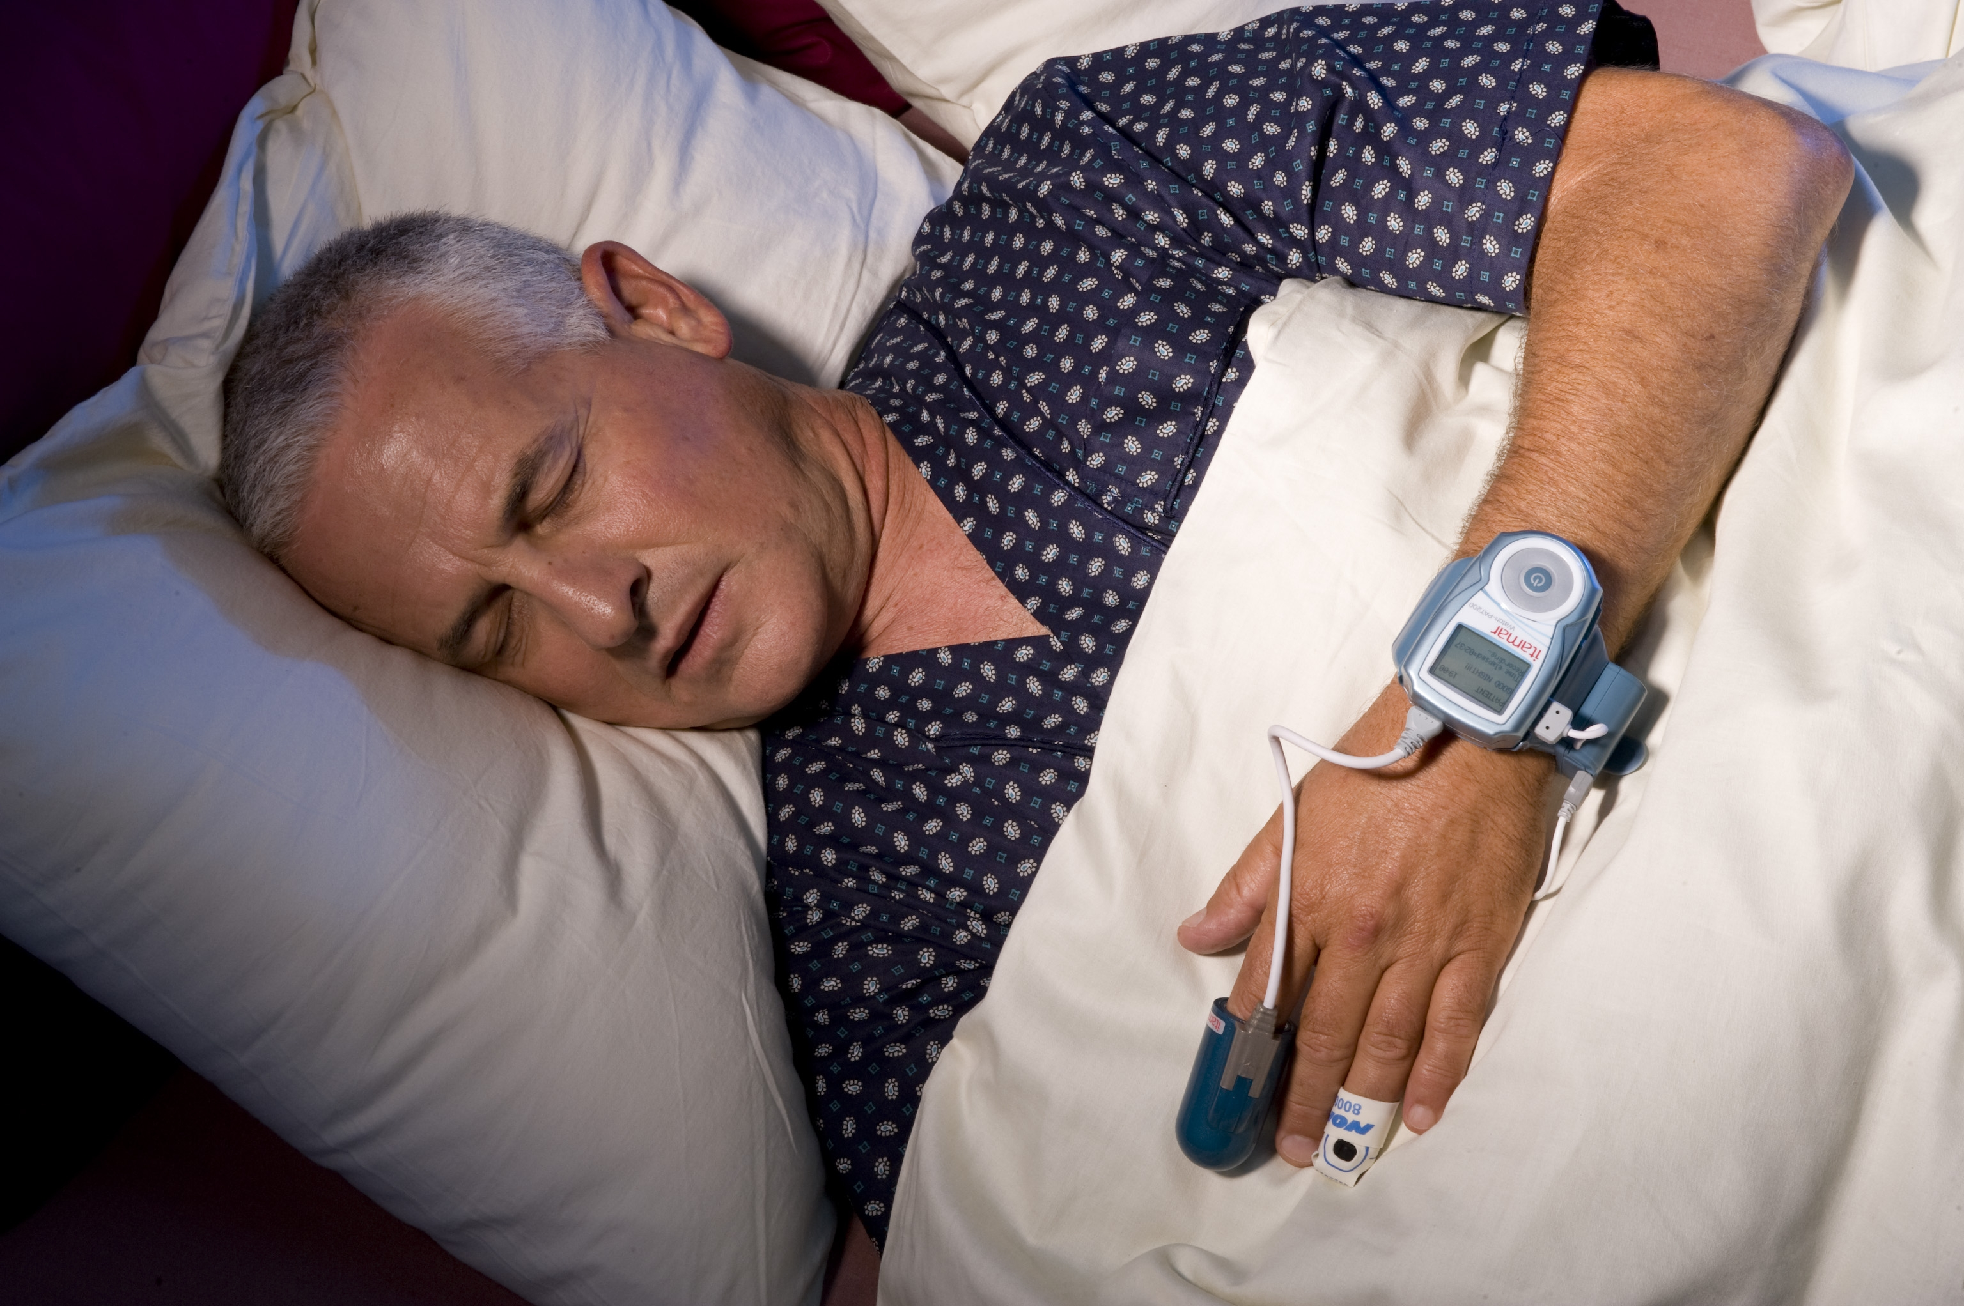
Objective:Actigraphy
An alternative method that works similarly, measures gross motor activity and is a device worn on the wrist or leg.
Has been validated as a useful means of calculating sleep time and wakefulness.
Notes:
(Marino et al,. 2013) Our sleepfit is an actigraphy method of measuring sleep that provides objective patient data and is the most accurate and reliable way to measure sleep within the comfort of your home!

Slide 7
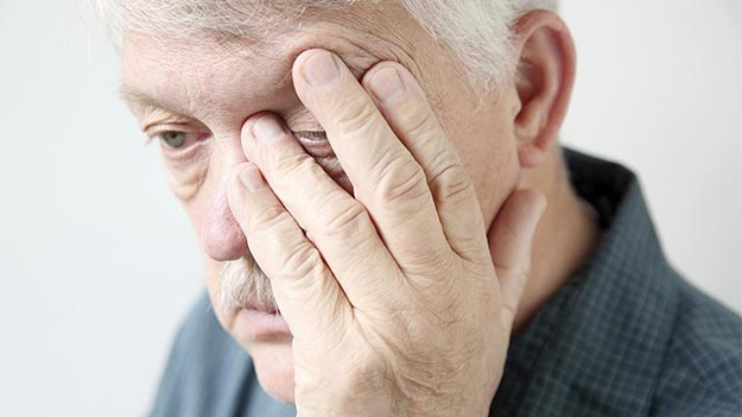
Subjective Measuring Tools
These are scales composed on questions addressing sleep habits and patterns, the information they provide help determine whether individual’s perceive their sleep pattern a problem or not.
Many different tools designed, must be careful how reliable they are and what exactly they measure.
Notes:
(Richardson et al., 2007) We used the Sleep Condition Tool to measure this, because it is short, straight-forward, standardized, been tested before and shows validity and reliability. Therefor you can trust the results provided to you by your sleepfit, it is a standardized tool made personal by your results.

Slide 8
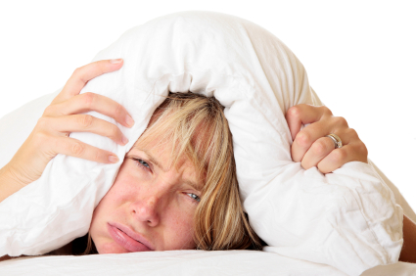
Common Sleep Disorders
Insomnia
Snoring
Sleep apnea
Sleep deprivation
Restless leg syndrome
Notes:
Richardson et al., 2007)
Through the use of our sleepfit device you can find out more about your sleeping patterns, and help identify some of the most common sleeping disorders.

Slide 9
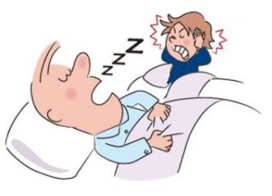
Snoring
When the flow of air from your nose or mouth to your lungs makes the tissues of your throat vibrate when you sleep.
Tx: Through lifestyle changes such as: stop smoking, drinking, influence sleeping patterns,

Slide 10
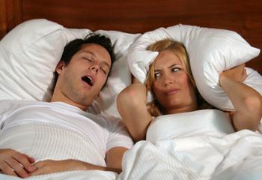
Sleep Deprivation
Amount of sleep a person needs to get to clear accumulated sleep debt over time.
Tx: Get more sleep, develop healthy sleeping habbits
Notes:
Sleepfit can track wrist movement and therefore help tell you how much sleep you possibly didn’t get based on tossing and turning in bed.

Slide 11
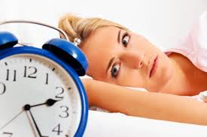
Insomnia
Habitual inability to sleep that can lead to mental disorders.
Seldom properly assessed, diagnosed, or treated.
Lack of public acknowledgement and education
Tx: treat underlying
cause/illness, sleep
Habits, behavior therapies
Notes:
(Espie, Kyle, Hames, Gardani, Fleming & Cape, 2014)
Tracking of wrist movement, and sounds overtime can help you determine if you have insomnia through our sleepfit.

Slide 12
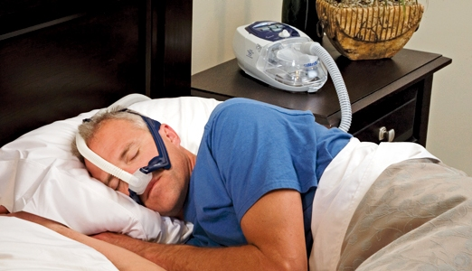
Sleep Apnea
People with sleep apnea stop breathing for up to 400 times a night, the intervals last anywhere from 10-30 seconds, before they abruptly start breathing again.
Tx: Losing weight, sleeping on your side, mouthpiece may help, wearing a CPAP or BIPAP machine overnight that help you breath.
Notes:
Richardson et al., 2007)
Sleepfit records your breathing rate per minute and can help you calculate if you suffer from sleep apnea.

Slide 13
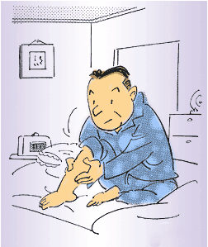
Restless Leg Syndrome
Disorder of part of the nervous system that causes an urge to move the leg. Feeling of uncomfortable sensations in the legs.
Tx: leg massages, heating pad/ice pack, vibrating pad, hot baths, good sleeping habits, & medications
Notes:
(Espie et al., 2014)
By tracking movement and recording sound Sleepfit can help determine if you suffer from restless leg syndrome.

Slide 14
Sleep Condition Indicator (SCI)
Eight item scale that measures:
Concerns about getting to sleep
Remaining asleep
Sleep quality
Daytime personal functioning
Daytime performance
Duration of sleep problem
Nights per week having a sleep problem
Extent troubled by poor sleep
Notes:
Sleepfit collaborates with SCI. This tool subjectively measures how a patient perceives his or her own sleep. We decided to use this assessment tool instead of creating our own for this class, because we wouldn’t have enough time to design one and measure its validity and reliability in order to assure that it is measuring what we need it to measure accurately. SCI was measured using five study samples and tested for content validity, internal consistency, and concurrent validity SCI is a validated sleep assessment tool (Espie et al., 2014)

Slide 15
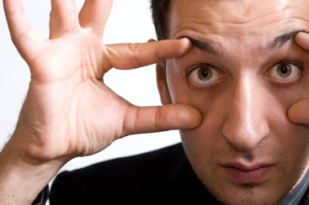
Break-down of SCI score:
There are 8 questions which measure 8 different areas concerning sleep. Scores are on a 5 point grade (0-4), total scores range from 0-32, where 0 indicates no problems with sleep and 32 indicates the most problems with sleep.
Notes:
(Espie et al., 2014)

Slide 16

SCI Results:
Scores of 0-10 are indicative of adequate sleep and if needed can be improved through building stronger sleeping habits. Continue to use our sleep tracking device to help monitor any changes in sleep pattern.
Scores of 11-20 are indicative of sleep disturbances and lifestyle changes need to be made with special attention to improve sleep pattern. Patient/client can self manage sleep problems and use our device to track sleep.
Scores of 20 and higher are indicative of poor sleep and individuals should seek medical/professional support for proper diagnosis and aggressive treatment. Continue to monitor sleep using our device to share data with healthcare team for evaluation.
Notes:
We used the SCI scale but calculated our own result system for simplicity and to better support Sleepfit’s purpose.

Slide 17
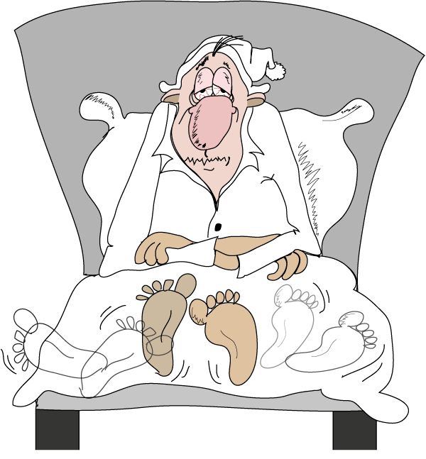
Even in Healthy People Lack of Sleep can:
Make you forgetful
Decrease your sex drive
Add to depression
Age your skin
Impair you ability to think
Impair your ability to make sound judgment
Cause car accidents
Cause weight gain
Increase your risk of death
Notes:
Sleepfit isn’t just for people with health and sleep problems, it is design for everyone who wants to promote a healthy lifestyle!

Slide 18
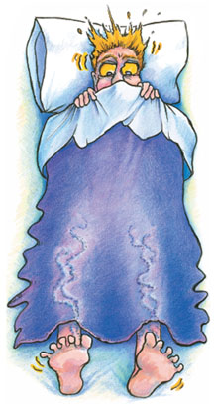
Sleep Deprivation Can Lead to Other Illnesses
Heart disease
Heart attack
Heart failure
Irregular heartbeat
High blood pressure
Stroke
Diabetes
Notes:
Sleepfit can help restore and maintain good sleeping patterns, which can help reduce your risk of developing other illnesses!

Slide 19
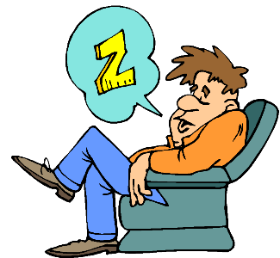
Sleep Tips
Cut back on caffeine
Stop smoking/reduce nicotine use
Eat healthy, avoid heavy meals before bed
Exercise regularly, at the best time for you
Relax before bedtime
Avoid discussing emotional or stressful issues before bed
Keep room quiet and comfortable
Avoid sleeping with pets
Notes:
Sleepfit also provides sleeping tips that can help you achieve optimal sleep!

Slide 20
References
Espie, C.A., Kyle, S.D., Hames, P., Gardani, M., Fleming, L., Cape, J., (2014). The sleep condition indicator : a clinical screening tool to evaluate insomnia disorder. BMJ Open
Marino, M., Yi, Li., Rueschman, J.W., Winkelman, J.M., Ellenbogen, J.M., Dllin, S.H., Berkman, L.F, Buxton, O.M., (2013). Measuring sleep accuracy, sensitivity, and specificity of wrist actigraphy compared to Polysomnography. PubMed Central
Richardson, A., Crow, W., Coghill, E., Turnock, C., (2007). A comparison of sleep assessment tools by nurses and patients in critical care. Journal of Clinical Nursing

